Slide 1
Information security.
Best Practices in Collecting Digital Evidence For DigiFirm Investigation Company.

Slide 2
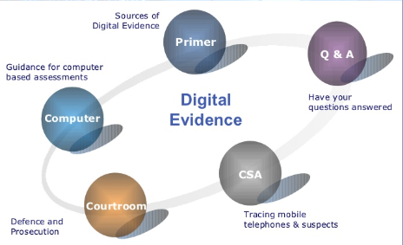
Introduction.
Digital evidence refers to information and data which are of value to an investigation carried out through electronic devices (Quick & Choo, 2018).
Digital evidence can be acquired when an electronic device is seized and secured for examination.
Evidence handling has been growing due to the expanding field of computer forensics.
Digital devices have been deemed necessary for addressing the needs of the rapidly changing computing settings (Quick & Choo, 2018).

Slide 3
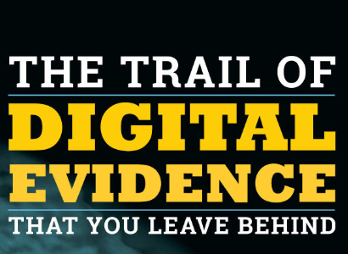
Rules of Digital Evidence.
    Admissible.
    Authentic.
    Complete.
    Reliable.
    Believable (Quick & Choo, 2018).
Notes:
The evidence handling process for DigiFirm company must be usable by the court or elsewhere. The evidence relates to an incident in a relevant way. The evidence practice must avail evidence for alternative suspects. In regards to reliability, the data sourced should be quite authentic. Moreover, the evidence-based practices should be easy to understand, and believable by a jury (Quick & Choo, 2018).

Slide 4
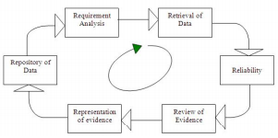
Best practice for the forensic investigation life cycle.
Requirement analysis.
Retrieval of data (Ashley, 2017).
Reliability.
Notes:
Requirement analysis required the investigator to define all the pieces of evidence and the investigation process. It entails data collection to complete the investigation process. Under the retrieval of data, the suspected devices and server storages serve as the source media and the information available is taken to other media for investigation. The next step includes reliability which checks for the originality of the data before creating the ideal image to affirm reliability and this should be underscored by DigiFirm.

Slide 5
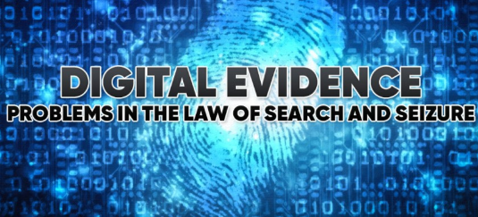
Continuation of best practice for the forensic investigation life cycle.
Review of the evidence.
Representation of evidence.
Repository of data (Gill & Phythian, 2018).
Notes:
Evidence review occurs after collecting forensic information where the investigator is required to extract the evidence data from media by use of tools such as forensic toolkits and encase for the analysis of the collected information from the suspected device (Gill & Phythian, 2018). The next practice entails representation of evidence. Due to the incidences of uncertainty in the validity and acceptability, the digital evidence tends to be equally essential to represent the evidence in such a form that can be understood by the court. Herein, the investigator is required to represent the evidence in a way that the pieces of evidence will be clear and understandable. Lastly, the repository of data entails archiving essential data for future use and this is also an important principle for DigiFirm.

Slide 6
Guidelines for best practice in collecting digital evidence.
Avoid touching the crime gadgets not unless you are required by digital forensics.
Document the location as well as a condition before touching anything.
Record the manufacturer type and serial numbers of the device (Ashley, 2017).
Record the date, time, personnel, and purpose for every transfer of data.
Store the evidence in a secure place.
Notes:
Avoid touching the crime gadgets not unless you are required by digital forensics since turning on and off can alter a lot of information in the machine. Try to document the location as well as a condition before touching anything by taking a photo where possible. Record the manufacturer type and serial numbers of the device to ensure identification of the gadget. Record the date, time, personnel, and purpose for every transfer of data (Ashley, 2017). Store the evidence in a secure place while avoiding access to other people who can alter or even destroy the digital evidence.

Slide 7
Recommendations for the Digifirm.
DigiFirm should consider performing regular backups (Ashley, 2017).
The firm should enhance auditing on workstations, servers, and network devices.
It should also consider forwarding the audit records for secure, centralized log servers.
The organization should focus on maintaining databases of file hashes for integrity checking.
Notes:
The firm should consider performing regular backups. The firm should enhance auditing on workstations, servers, and network devices. Digifirm should consider forwarding the audit records for secure, centralized log servers. The organization should focus on maintaining databases of file hashes for integrity checking.

Slide 8
Continuation of Recommendations for the Digifirm
The organization should have a capability to perform computer and network forensics.
DigiFirm should define which parties should handle each aspect of forensics.
Incident handling teams should depict a robust forensic capability (Ashley, 2017).
Many teams within an organization should participate in forensics.
Forensic considerations should be addressed in policies.
Organizations should establish and maintain guidelines and procedures for performing forensic tasks.
Notes:
The organization should have the capability to perform computer and network forensics to necessitate the most appropriate action. Digifirm should define which parties should handle each aspect of forensics to enhance accuracy and data sensibility (Ashley, 2017). Incident handling teams should depict a robust forensic capability by being able to perform any form of forensic investigation. Many teams within an organization should participate in forensics, and those forensic considerations should be addressed in policies to facilitate the necessary investigative behavior. Organizations should establish and maintain guidelines and procedures for performing forensic tasks to as a guide.

Slide 9
Conclusion.
Evidence handling has been growing with the field of computer forensics.
In this case, DigiFirm should dive deeper into the collection of forensic data.
The firm should address its forensic considerations through key policies.
The firm’s activities should be complemented with the guidelines and procedures for the improved performance of investigations

Slide 10
References.
Ashley, K. D. (2017). Artificial intelligence and legal analytics: new tools for law practice in the digital age. Cambridge University Press.
Gill, P., & Phythian, M. (2018). Intelligence in an insecure world. John Wiley & Sons.
Quick, D., & Choo, K. K. R. (2018). Digital forensic intelligence: Data subsets and Open Source Intelligence (DFINT+ OSINT): A timely and cohesive mix. Future Generation Computer Systems, 78, 558-567.

